Slide 1
Hardware
Raspberry Pi + SD card + power plug
BreadBoard + T-extension
Some wire
Resistor
LED: transparent (red), yellow, green
Switch
Buzzer
7-seg
Later: connect the bread board ground and power lines

Slide 2
Set Up
Open GS Page https://www.goldmansachs.com/
Enter WiFi password
Open web page https://lets-code-p.github.io/
Delete all previous versions, download new version in:
/Desktop/CodingWorkshop

Slide 3
Coding Workshop

Slide 4
Outline
Raspberry Pi
Run Python on Pi
Circuit design
Programme the Gadgets
Mini Project - Smart Home

Slide 5
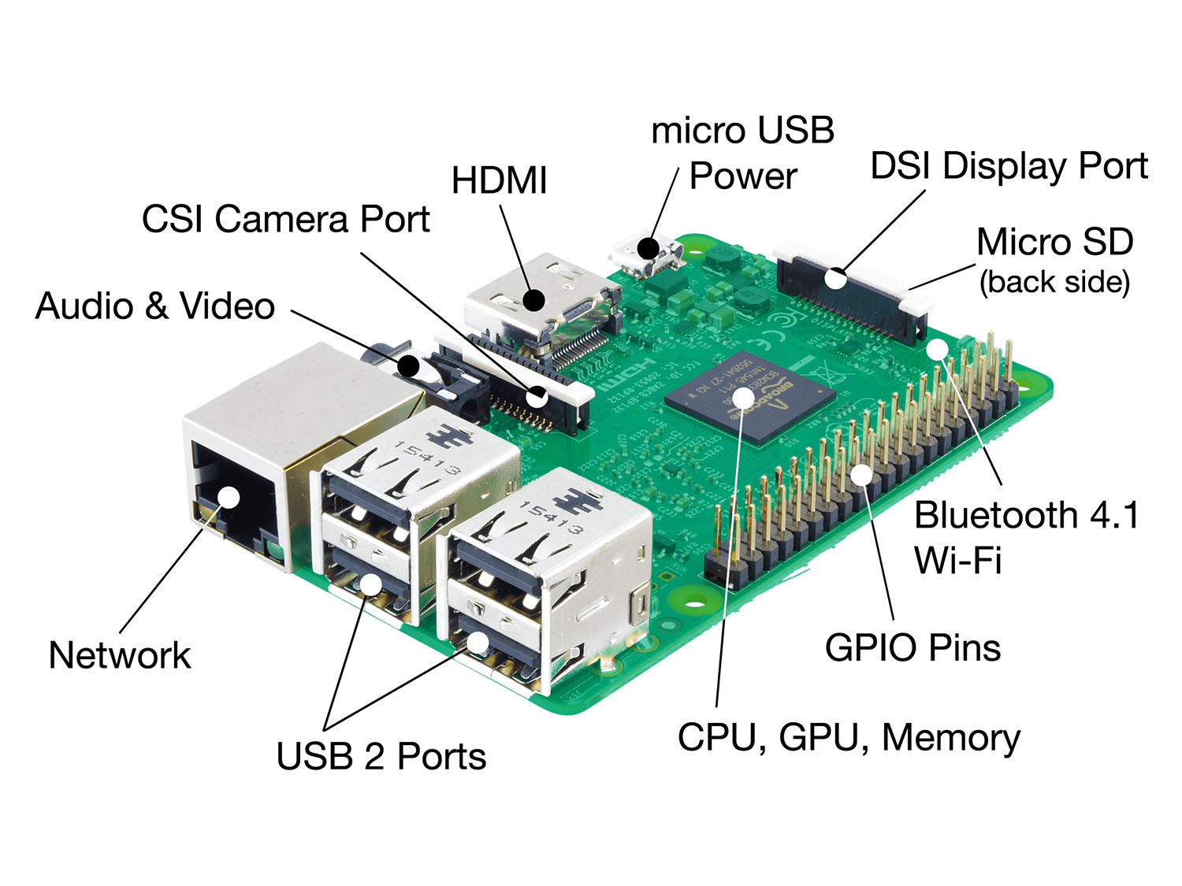
What is Raspberry Pi?
Notes:
https://www.raspberrypi.org/help/what-%20is-a-raspberry-pi/

Slide 6
“The Raspberry Pi is a credit-card sized computer..”
“able to interact with the outside world” => sensors, electronic gadgets
How does the interaction happen?
OS - SD card. Raspbian OS
I/O interface. GPIO

Slide 7
Python on Pi

Slide 8
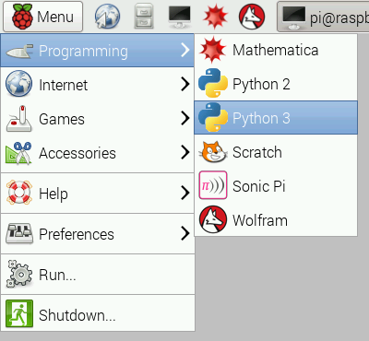
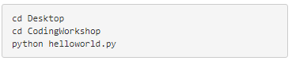
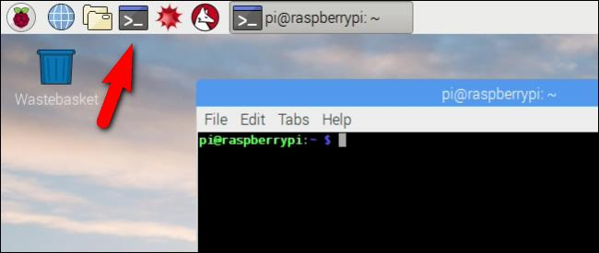
Python Programming on Pi
Notes:
Python Programming!
Write your first python program on the Pi!
Open a new Python program by opening the Python console and then clicking File> New.
Type in the below code: print(‘Hello World!’)
And save the file in the folder CodingWorkshop present on the Desktop as helloworld.py. To run this code, open the Raspberry-Pi Terminal and then run the following commands:
And there you have it, your first Python program on the Pi! :D

Slide 9
Circuit Design
Bread Board
Circuit Design Process
GPIO T-extension
Jumper wire

Slide 10
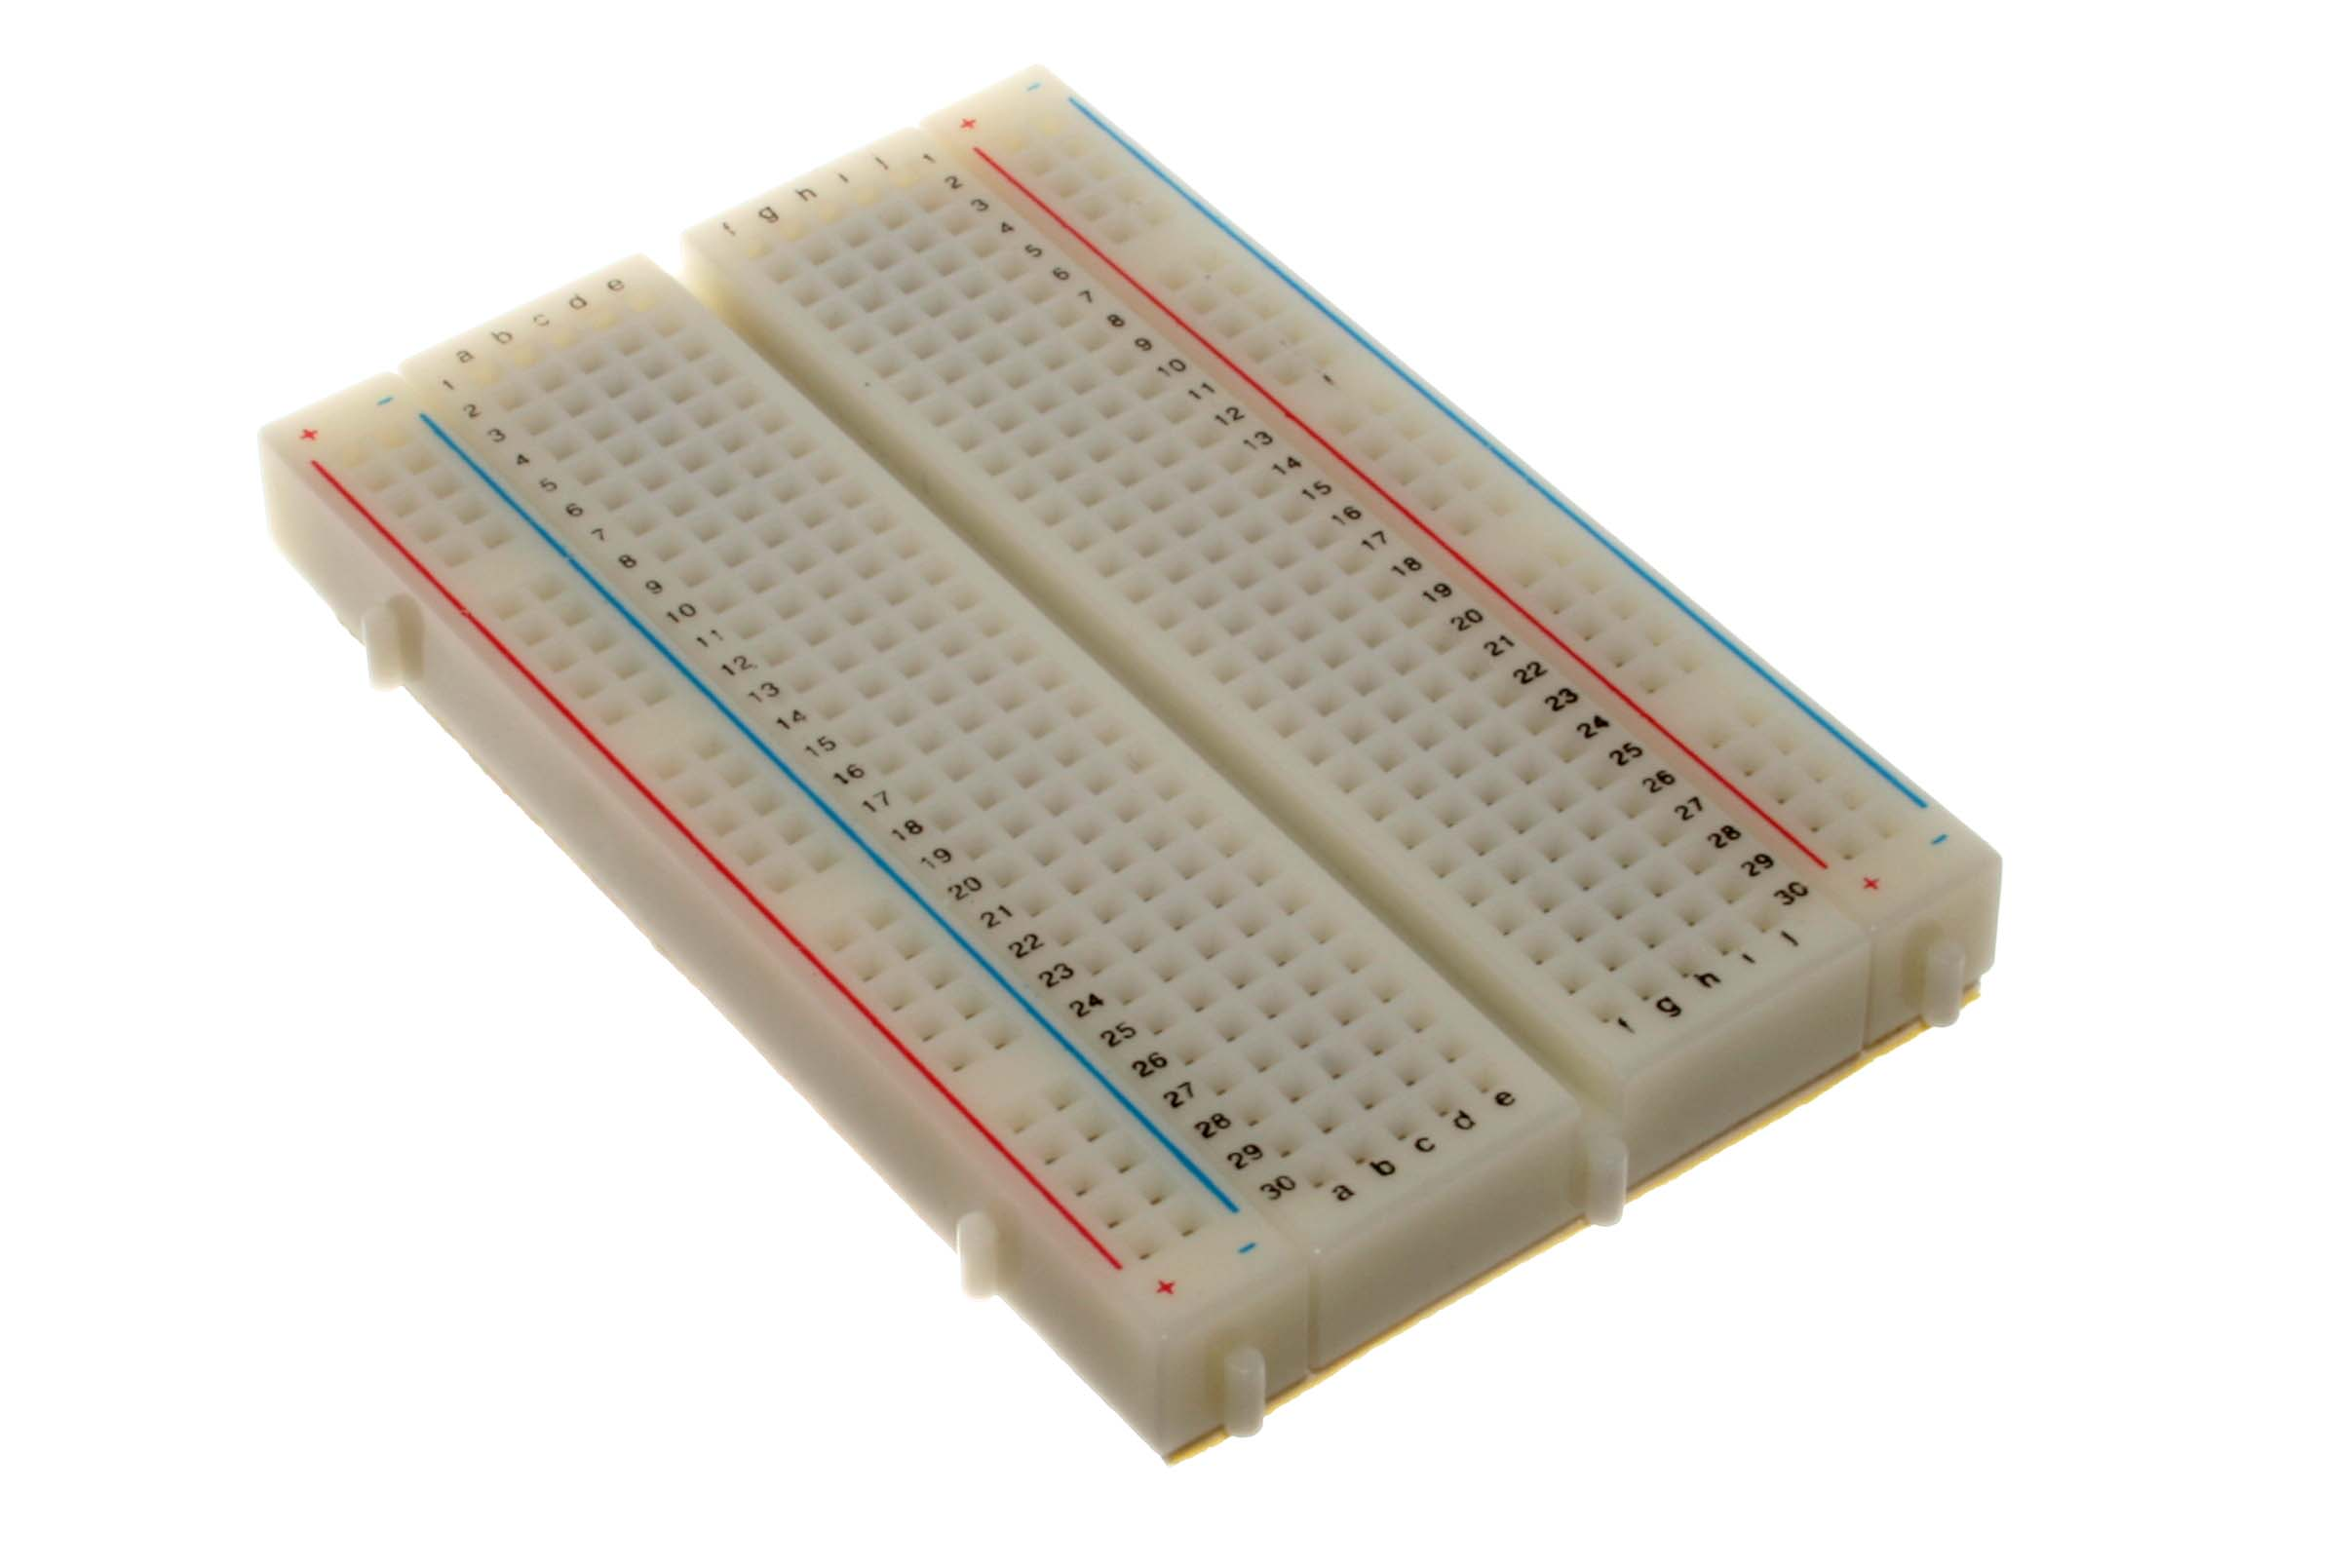
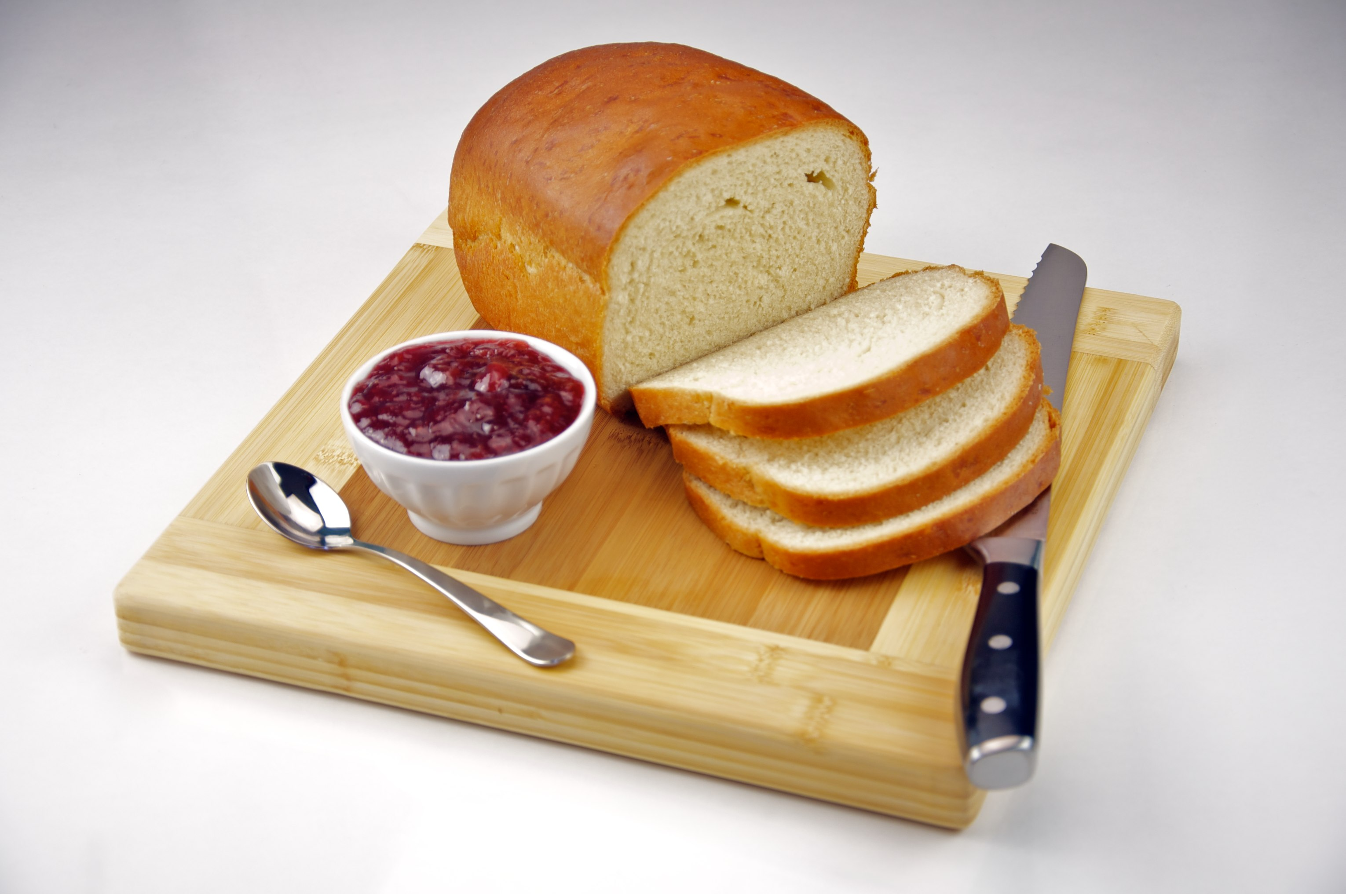
Bread Board?
Left: By oomlout - BREB-01 (Breadboard), CC BY-SA 2.0, https://commons.wikimedia.org/w/index.php?curid=19867043
Right: By Evan Swigart from Chicago, USA - Homemade White Bread with Strawberry Jam, CC BY 2.0, https://commons.wikimedia.org/w/index.php?curid=11626953

Slide 11
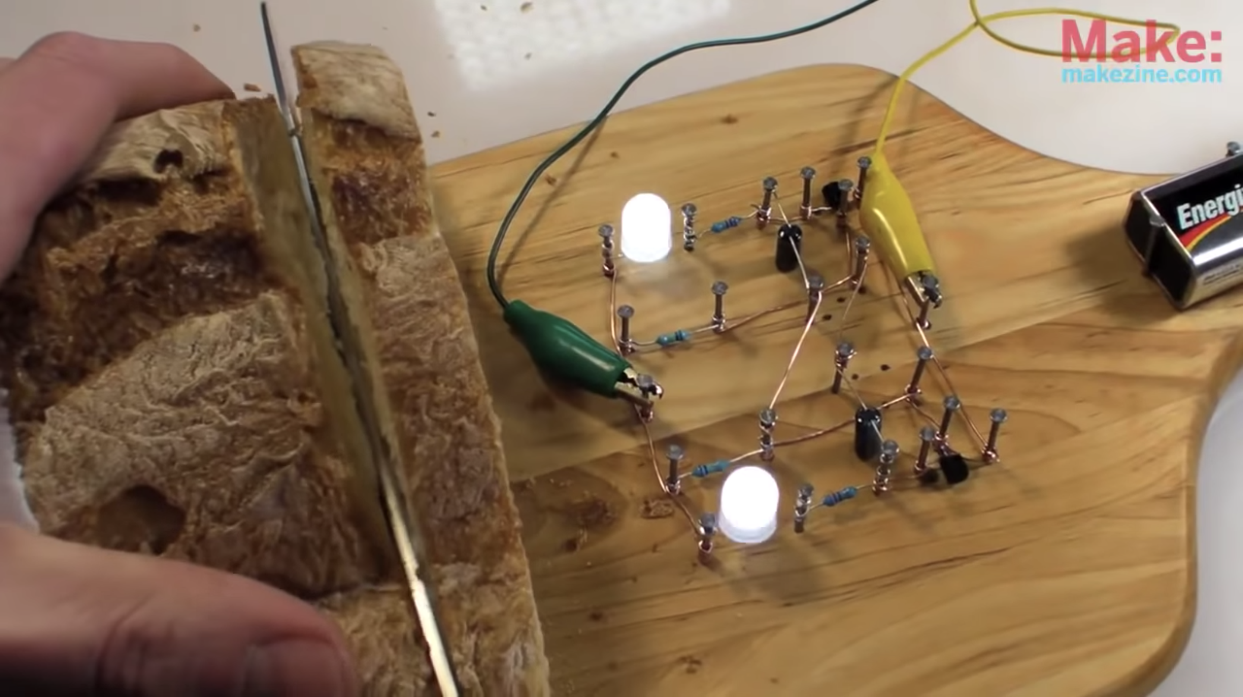
Bread Board
Collin's Lab: The REAL Breadboard, https://www.youtube.com/watch?v=HrG98HJ3Z6w&gl=SG&hl=en-GB

Slide 12
Solder-less Bread Board
By oomlout - BREB-01 (Breadboard), CC BY-SA 2.0, https://commons.wikimedia.org/w/index.php?curid=19867043

Slide 13
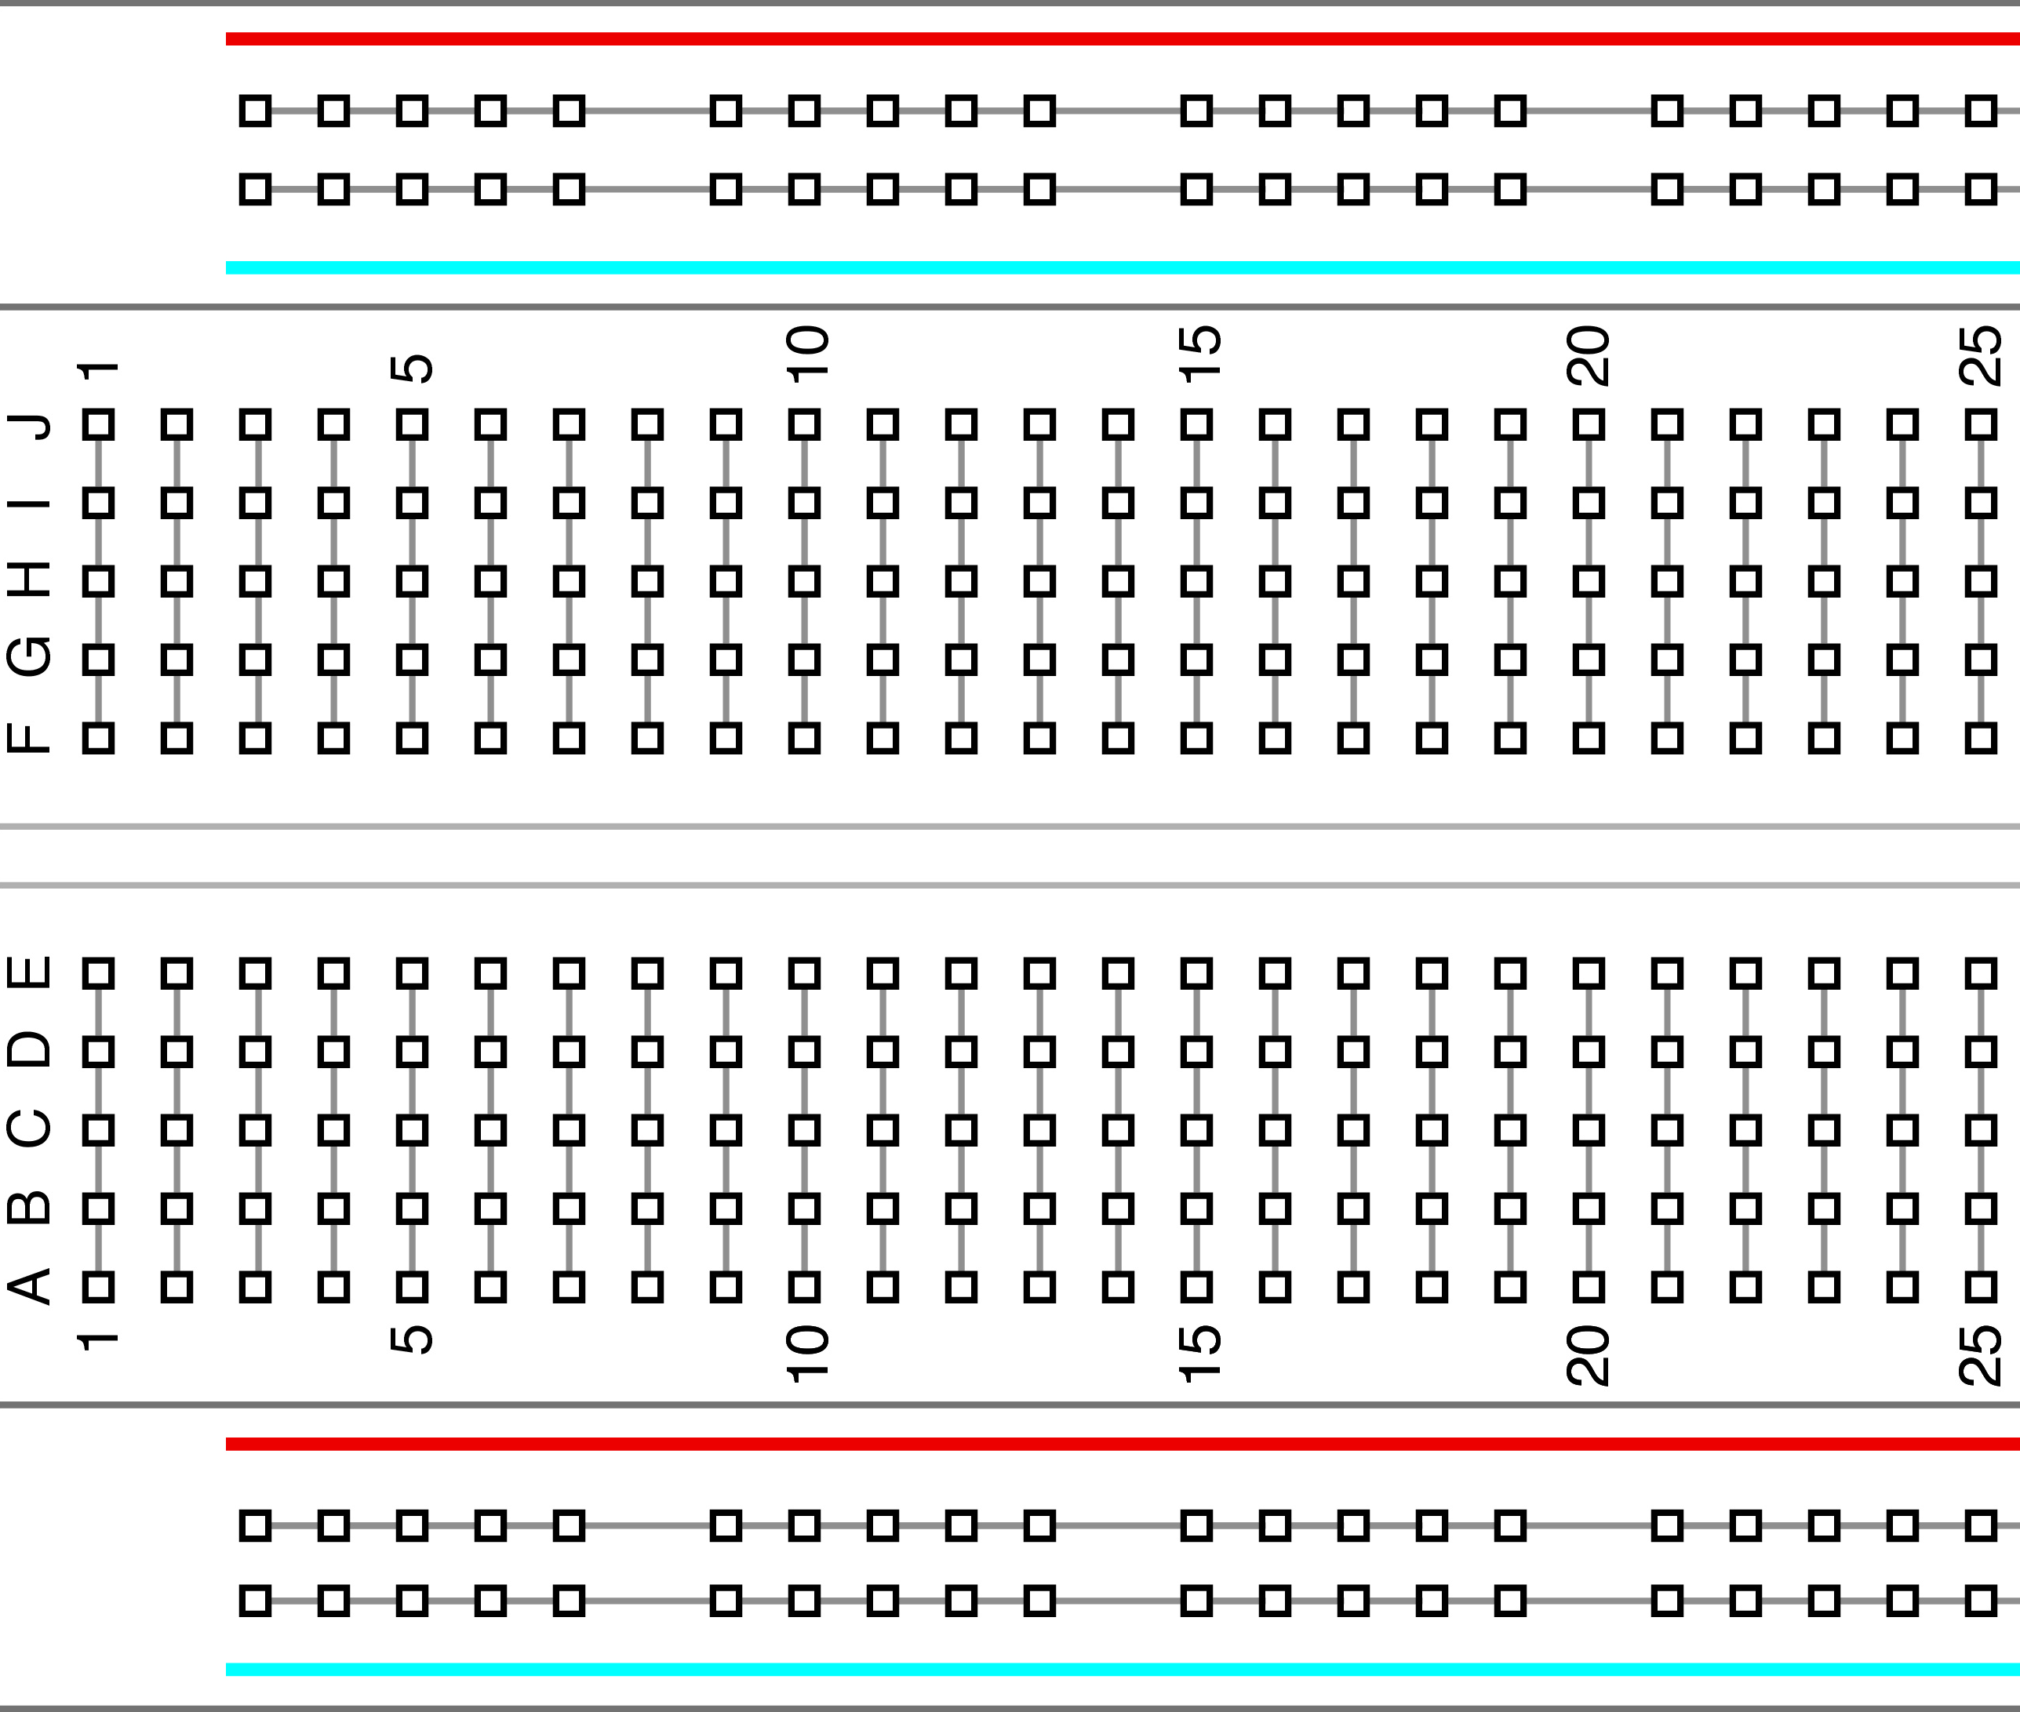
↙︎All the holes in this row are connected
↖︎All the holes in this row are connected
}
All the holes each column
are connected
}
All the holes each column
are connected
↙︎All the holes in this row are connected
↖︎All the holes in this row are connected
Notes:
Breadboard?
Just a board that has slots for easily connecting circuits and removing them. The black rows are connected as well as the blue and red columns.

Slide 14
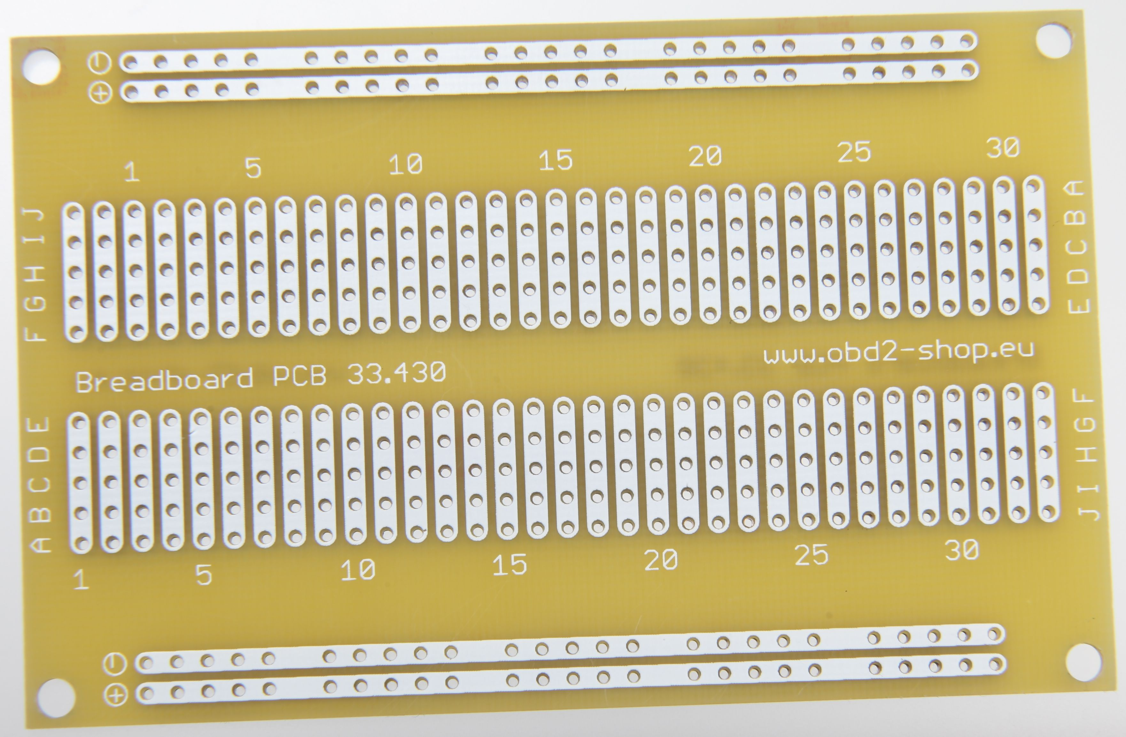
Printed Circuit Board
By Florian Schäffer - Own work, CC BY-SA 4.0, https://commons.wikimedia.org/w/index.php?curid=45535472

Slide 15
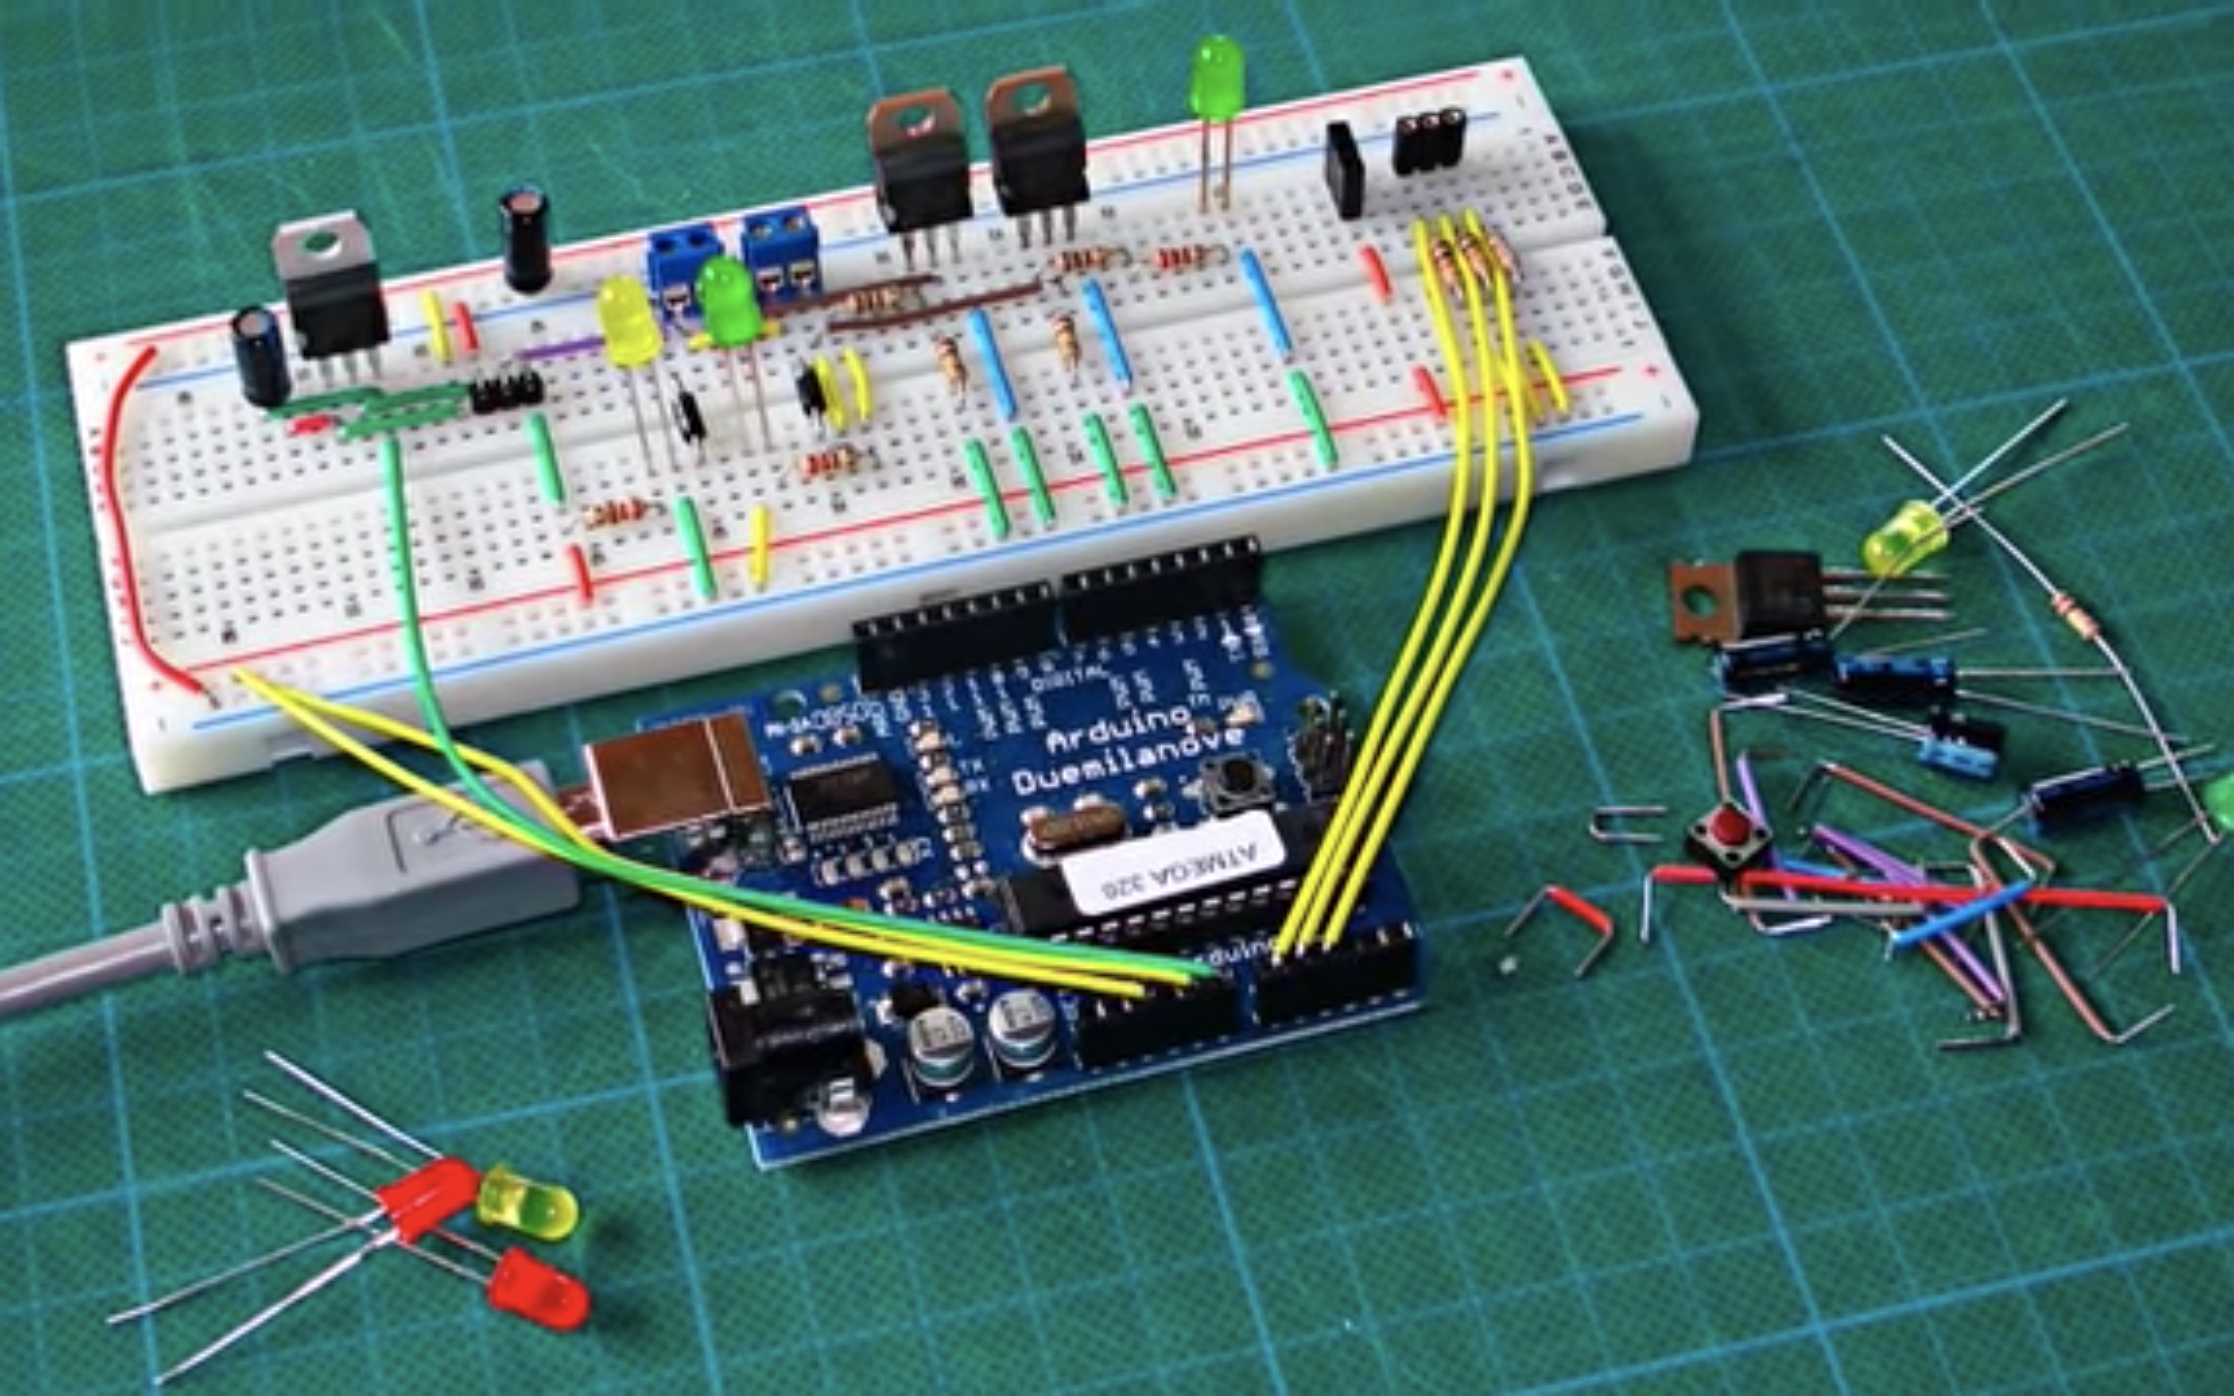
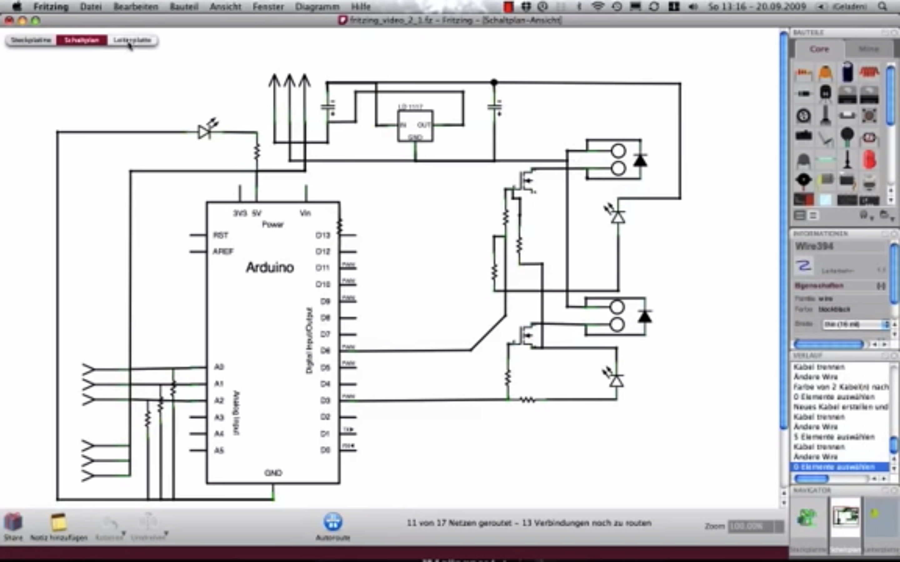
From Prototype to Commercial Electronics
By: http://fritzing.org/home/

Slide 16
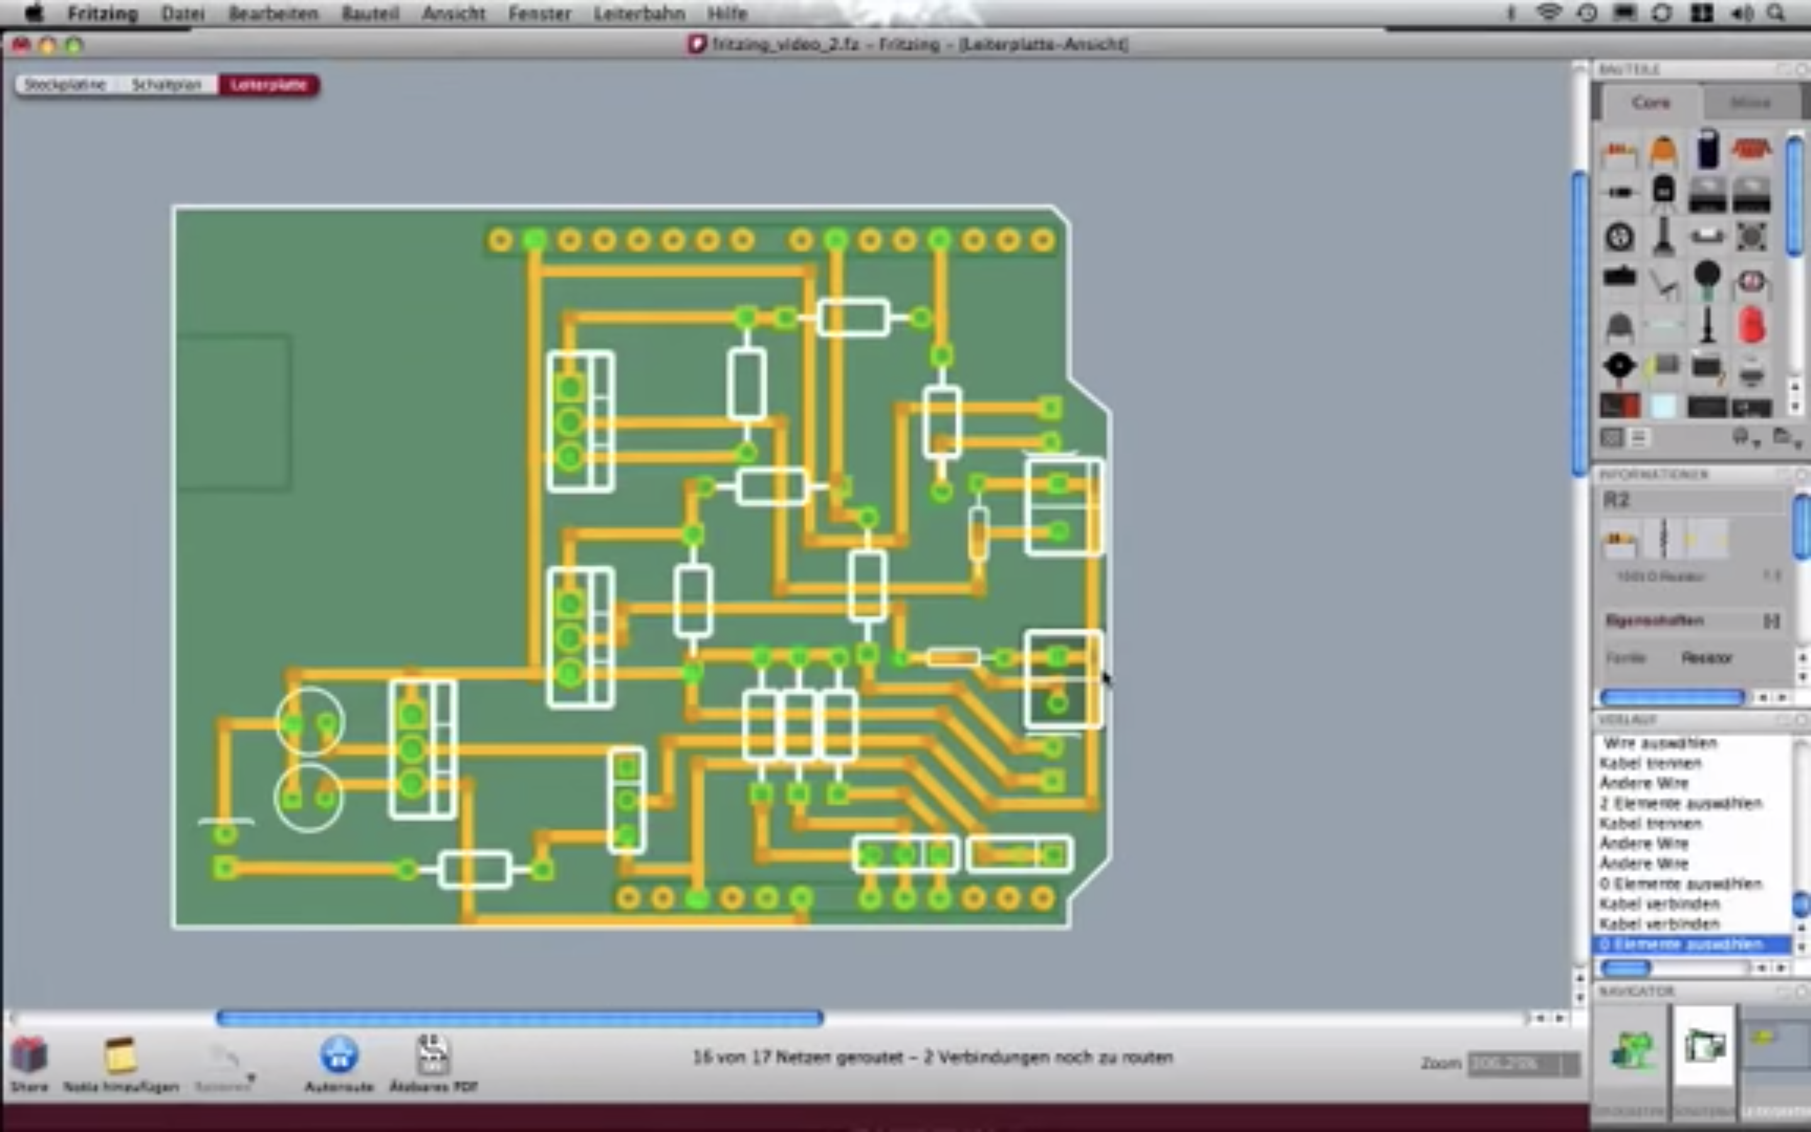
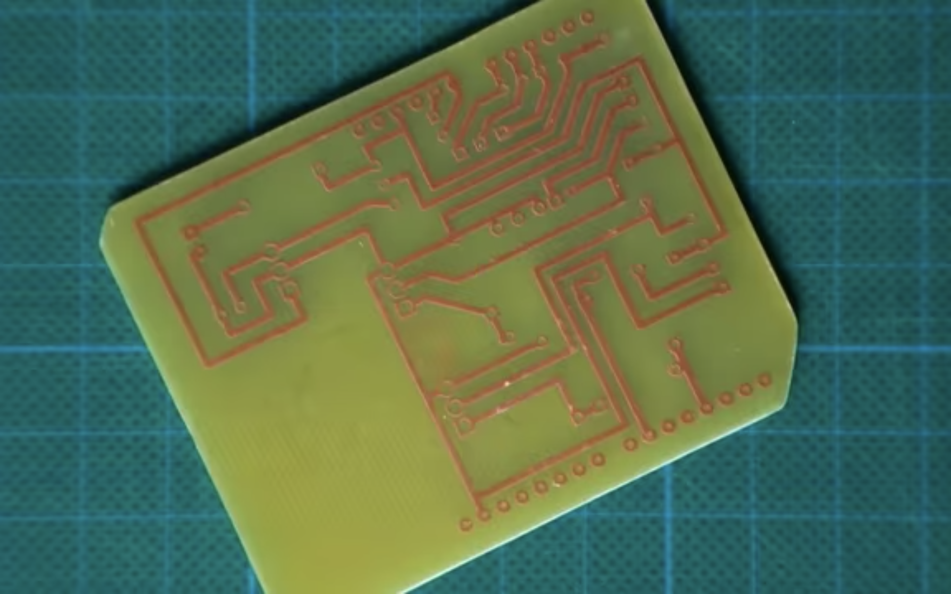
From Prototype to Commercial Electronics
By: http://fritzing.org/home/

Slide 17
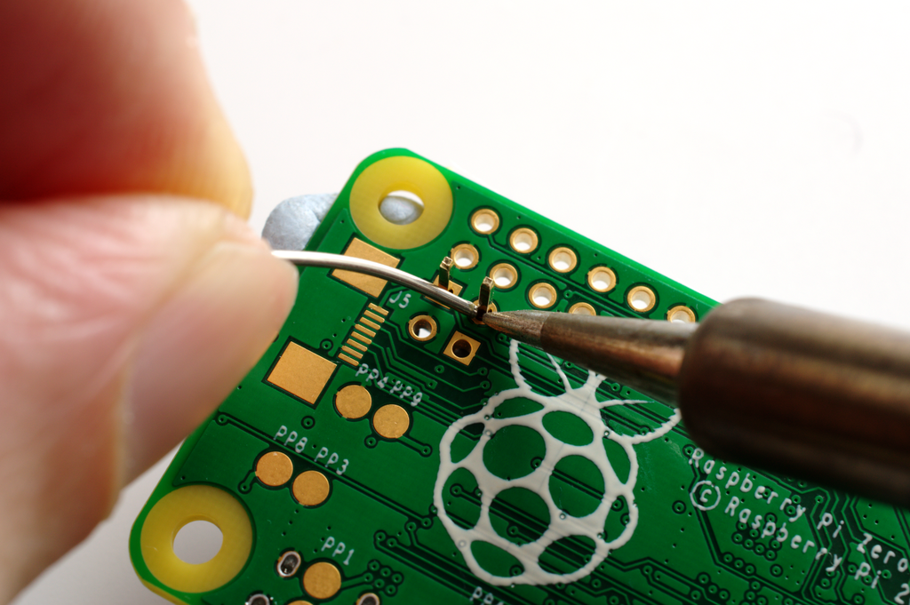
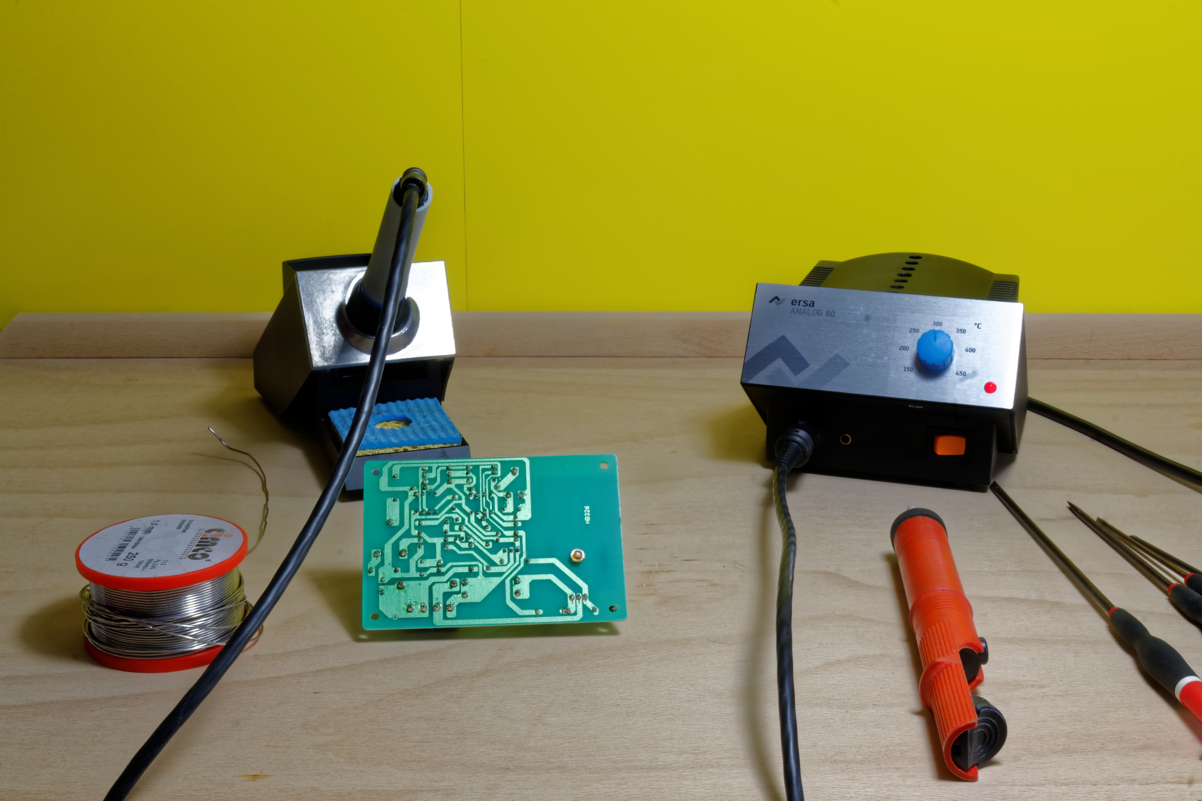
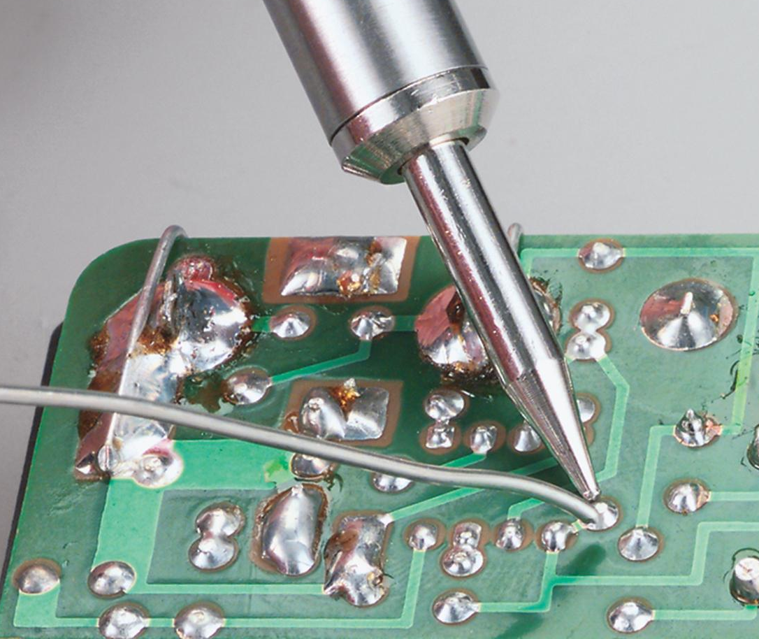
Top left: Gareth Halfacree from Bradford, UK [CC BY-SA 2.0 (https://creativecommons.org/licenses/by-sa/2.0)]
Botton left: https://m.media-amazon.com/images/S/aplus-media/vc/a40c0904-3a4c-427f-86cd-95a04a4bbf87.jpg
Right: https://pxhere.com/en/photo/1058819
Notes:
besides circuit design:
chip design
coding

Slide 18
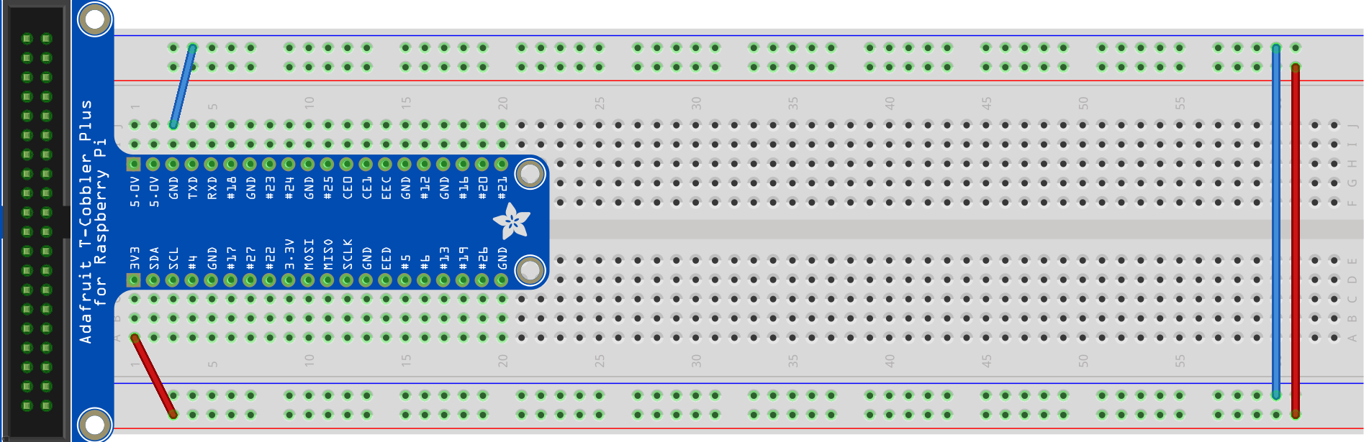
Initial Power Connection
Connect the 3.3V row to the red column and the GND to the blue column
Connect both blue columns and both red columns so that they are the same
Extra step for transparent breadboard: Connect the middle

Slide 19
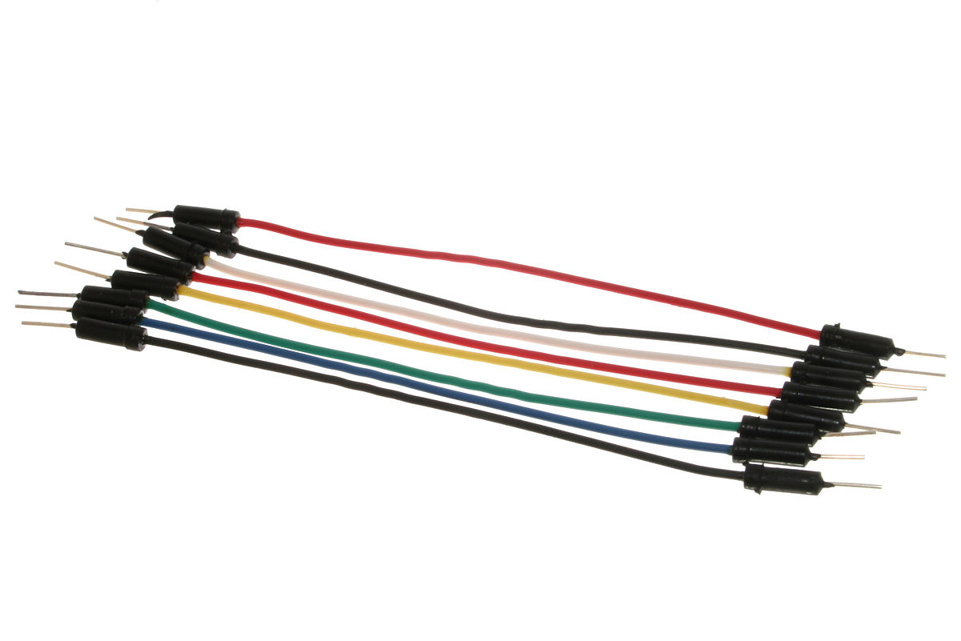
Jumper Wire
Top: By oomlout - A few Jumper Wires, CC BY-SA 2.0, https://commons.wikimedia.org/w/index.php?curid=19866418
Bottom: By oomlout - Jumper Wires with Crocodile Clips (x10) - JUMP-03Uploaded by bomazi, CC BY-SA 2.0, https://commons.wikimedia.org/w/index.php?curid=19866590

Slide 20
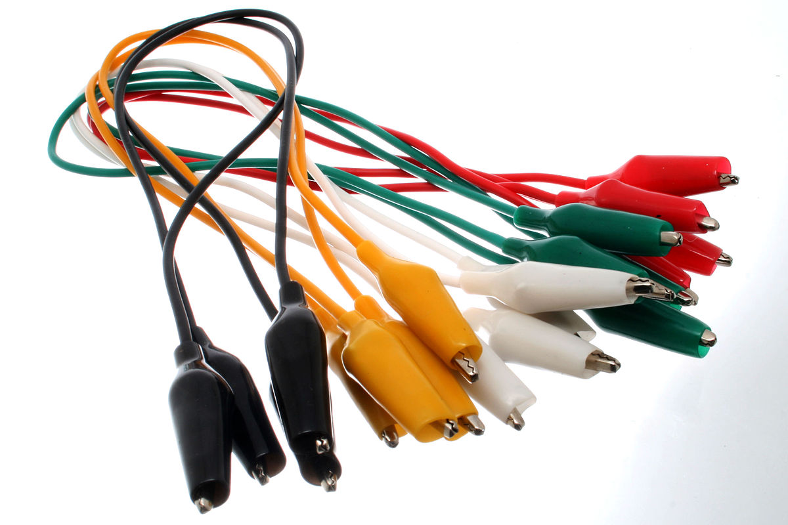
Jumper Wire
Top: By oomlout - A few Jumper Wires, CC BY-SA 2.0, https://commons.wikimedia.org/w/index.php?curid=19866418
Bottom: By oomlout - Jumper Wires with Crocodile Clips (x10) - JUMP-03Uploaded by bomazi, CC BY-SA 2.0, https://commons.wikimedia.org/w/index.php?curid=19866590

Slide 21
Gadgets
LED (Light-emitting Diode)
Switch
Buzzer
7 Segment Display

Slide 22
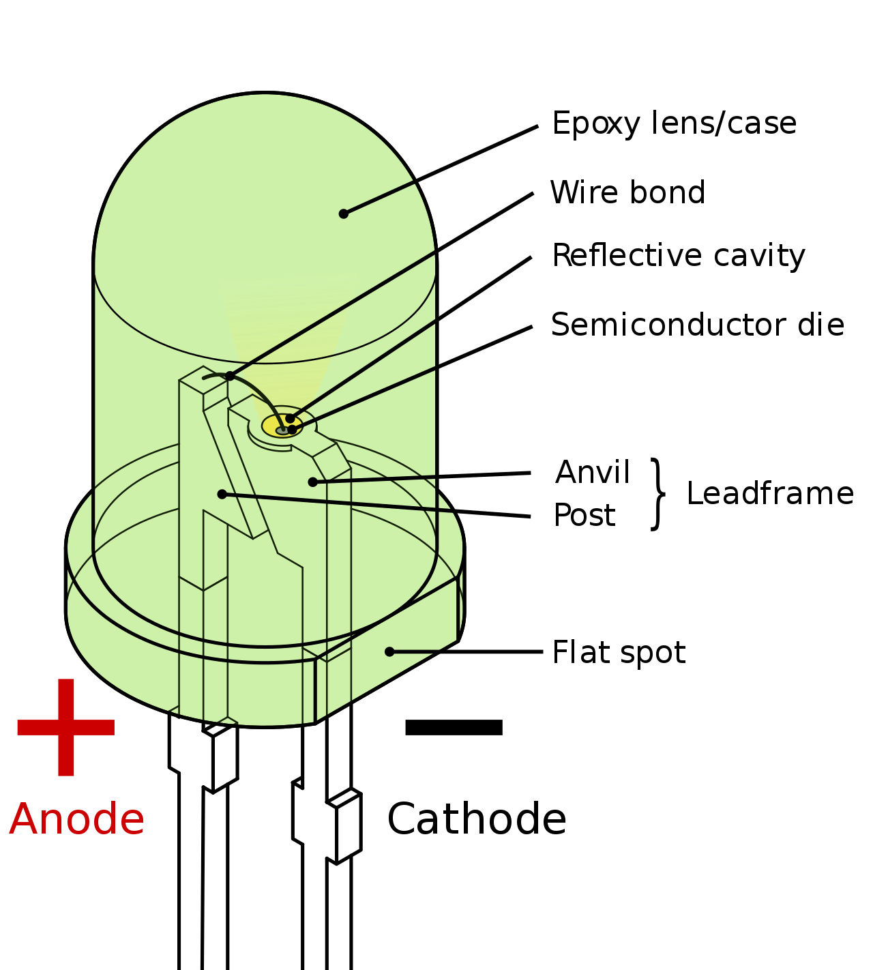
Light-emitting Diode
By Inductiveload - Own work by uploader, drawn in Solid Edge and Inkscape., Public Domain, https://commons.wikimedia.org/w/index.php?curid=6431789
Notes:
Diode
Pn junction
N-type p-type,
Power -> force holes and electrons to combine
Electron -> Drop in energy level -> release energy in the form of photon
The amount of energy determine frequency => the color of light
Another way of diff color : coat a layer/diff color of plastic wrapping -> cheaper

Slide 23
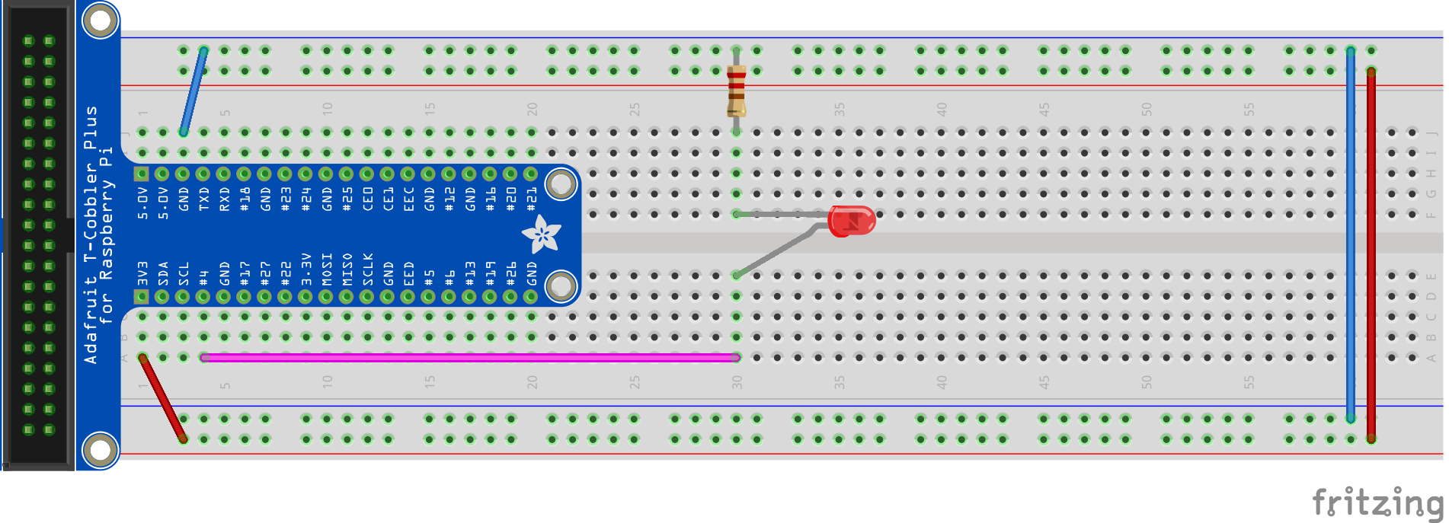
LED - Circuit
Resistor from ground to a row
Wire from pin #4 to a different row
LED connecting both the rows with the longer side connecting to pin #4

Slide 24
LED - Code
import RPi.GPIO as GPIO
import time
GPIO.setmode(GPIO.BCM)
GPIO.setwarnings(False)
GPIO.setup(4,GPIO.OUT)
print('LED on')
GPIO.output(4,GPIO.HIGH)
time.sleep(0.5)
print('LED off')
GPIO.output(4,GPIO.LOW)
time.sleep(0.5)

Slide 25

Make the LED blink 5 times
Make the LED blink at different frequency
Make different LEDs blink at different frequency
What are the resistance of our resistors?
Hint: Resistor Color Code
Notes:
https://www.digikey.sg/en/resources/conversion-calculators/conversion-calculator-resistor-color-code-4-band

Slide 26
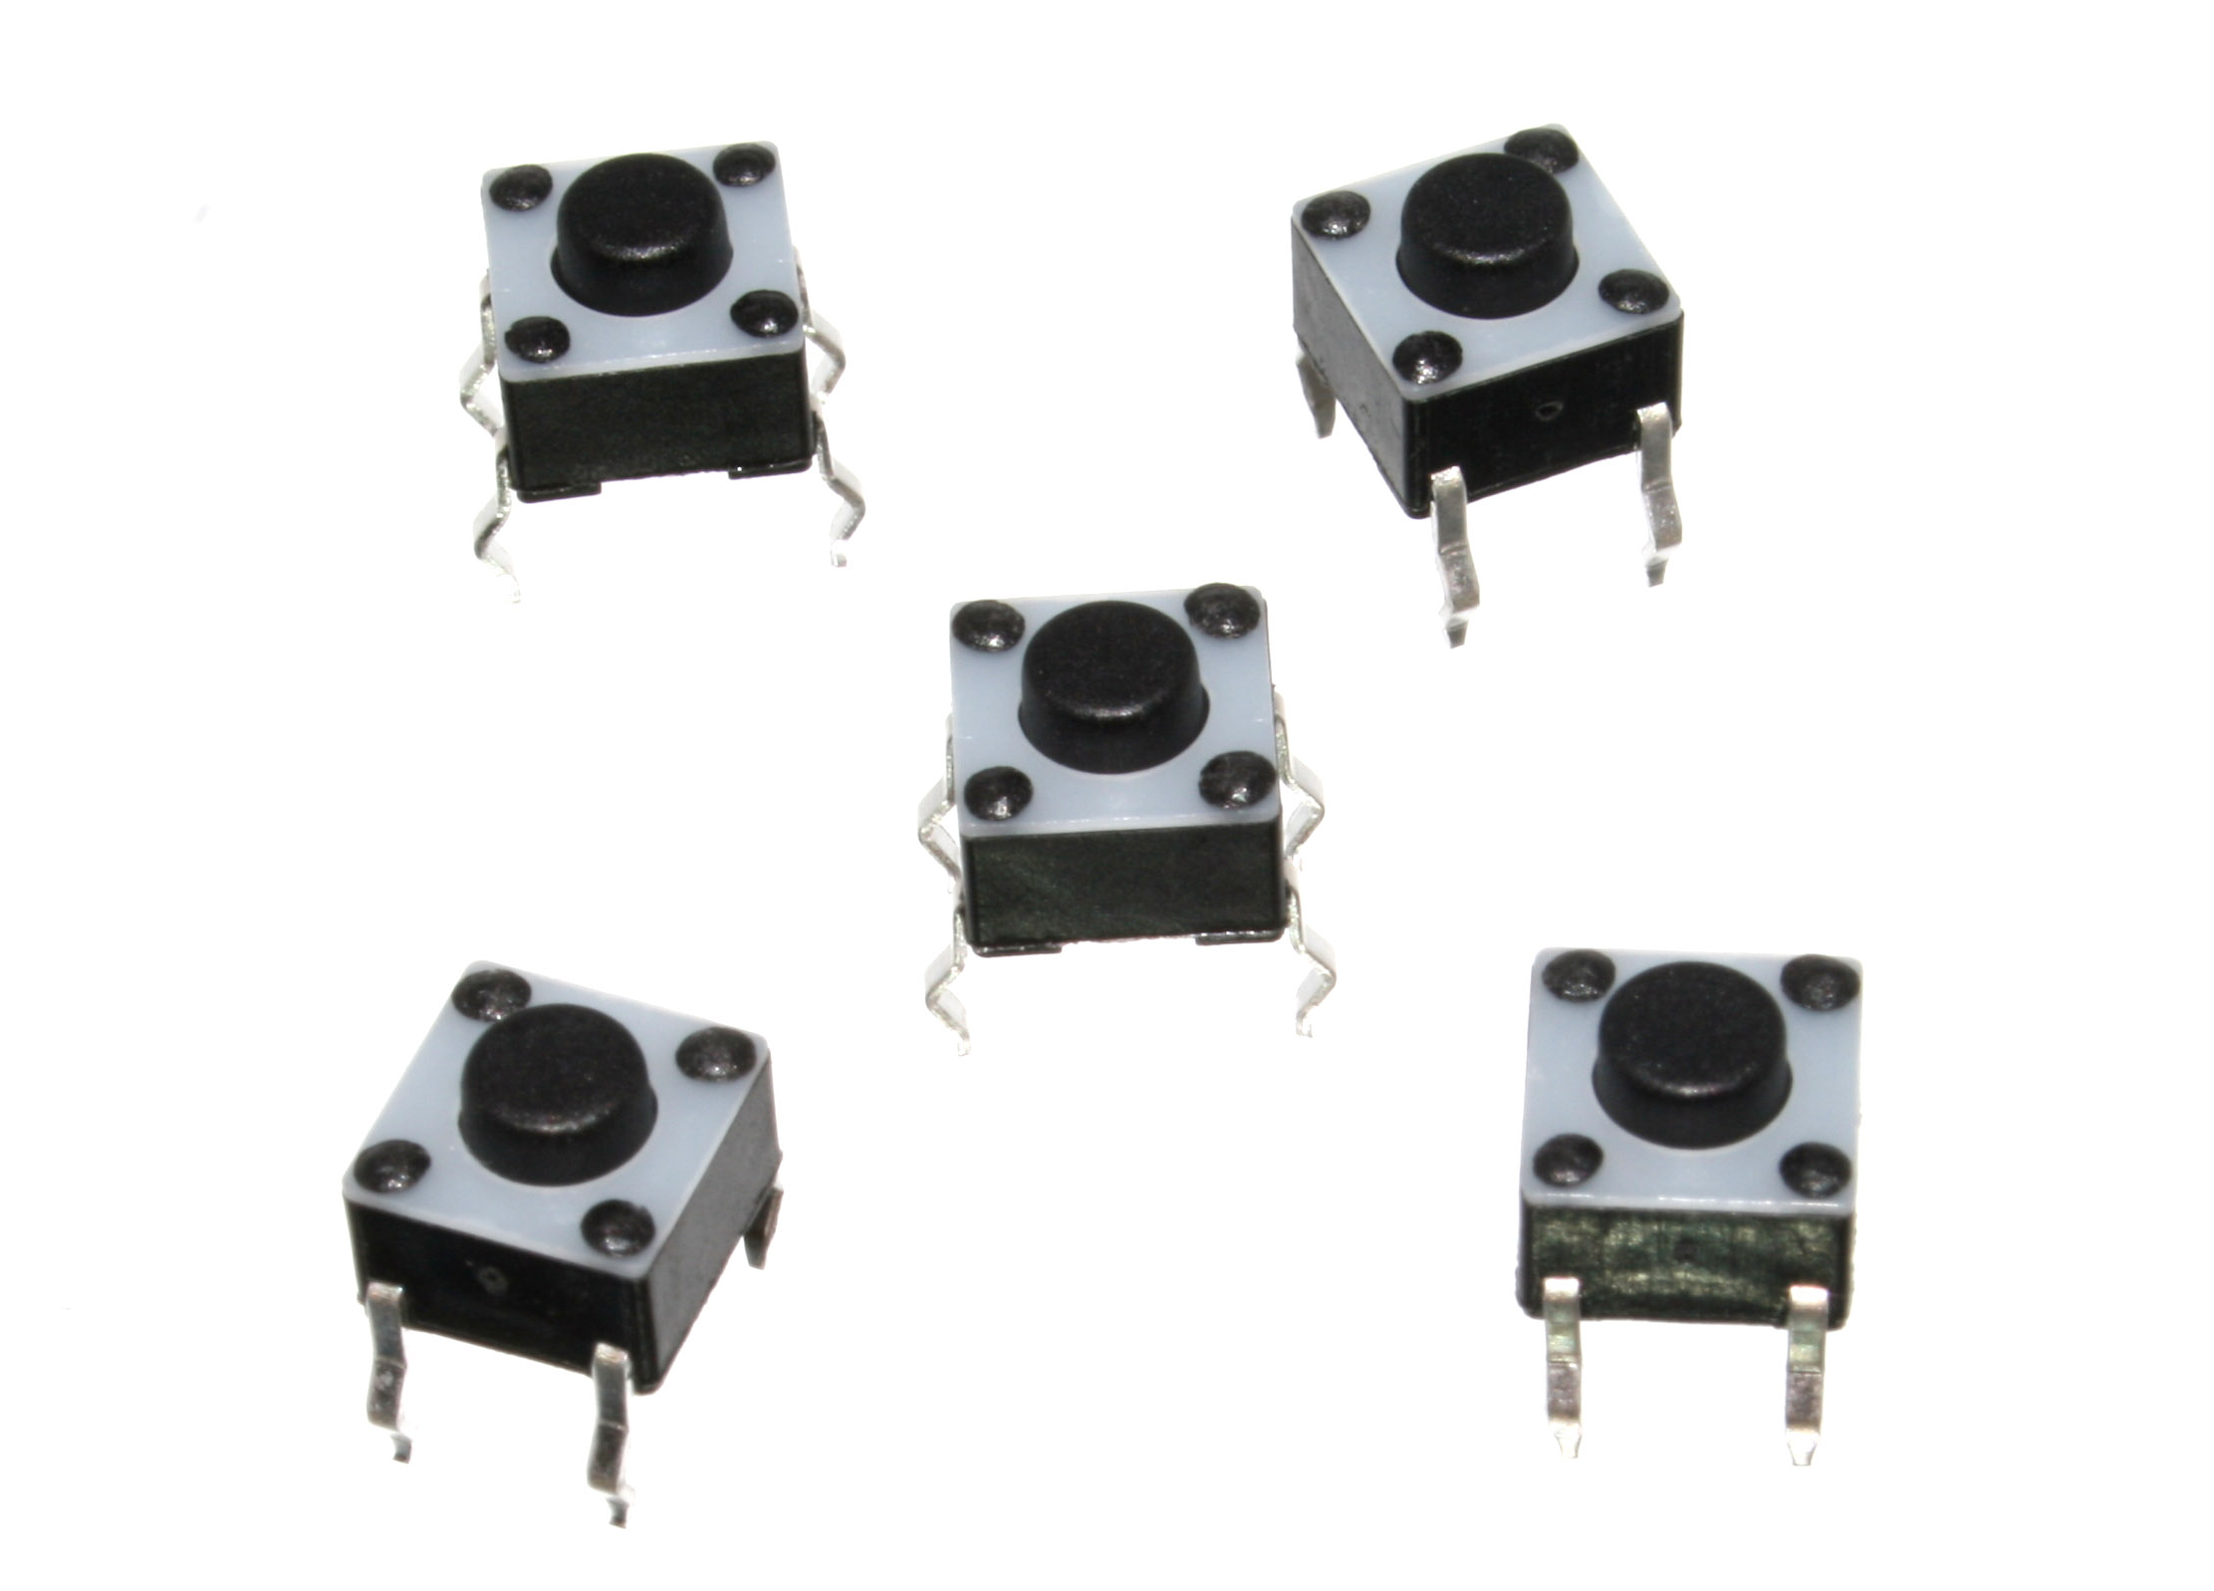
Switch
x
By oomlout - BUTT-01 (Pushbuttons), CC BY-SA 2.0, https://commons.wikimedia.org/w/index.php?curid=23281155

Slide 27
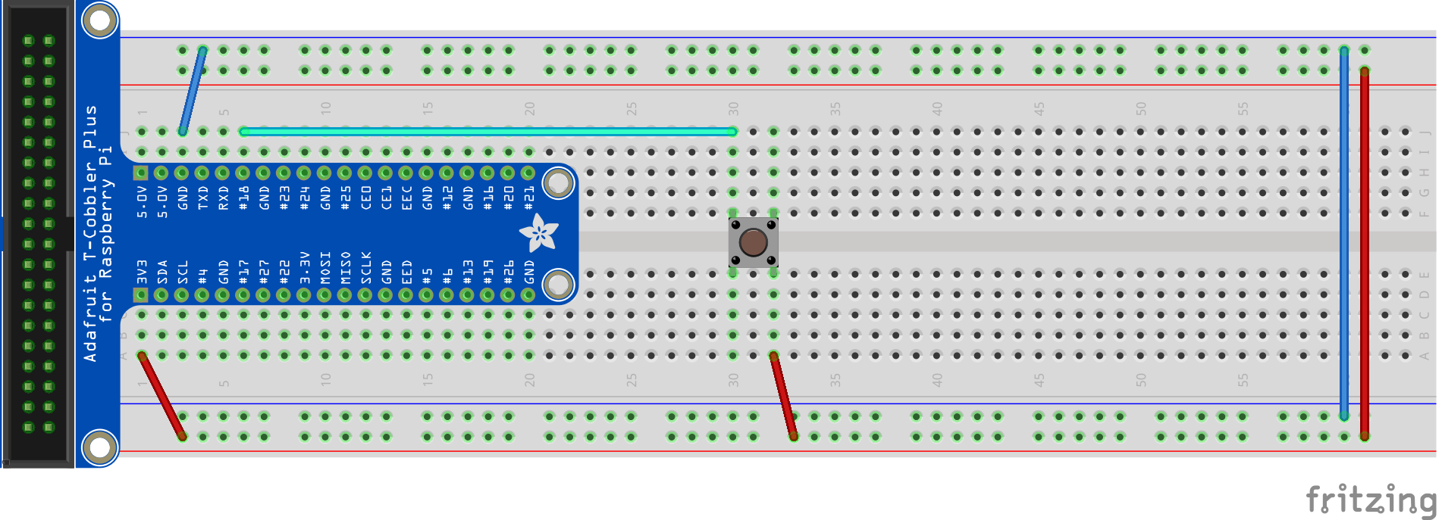
Switch - Circuit
Plug in switch in the middle
Wire from 3.3V (red line) to a row
Wire from pin #18 to a different row
Notes:
http://razzpisampler.oreilly.com/ch07.html

Slide 28
Switch - Code
import RPi.GPIO as GPIO
import time
GPIO.setmode(GPIO.BCM)
GPIO.setwarnings(False)
PORT_IN = 18
GPIO.setup(PORT_IN, GPIO.IN, pull_up_down=GPIO.PUD_DOWN)
while True:
input_state = GPIO.input(PORT_IN)
if input_state == 1:
print('Button Pressed')
time.sleep(0.2)

Slide 29
Count the number of times the button is pressed and print out on console
If we change code to: pull_up_down=GPIO.PUD_UP, how should we change the circuit accordingly?
Switch on the LED when the button is pressed

Slide 30
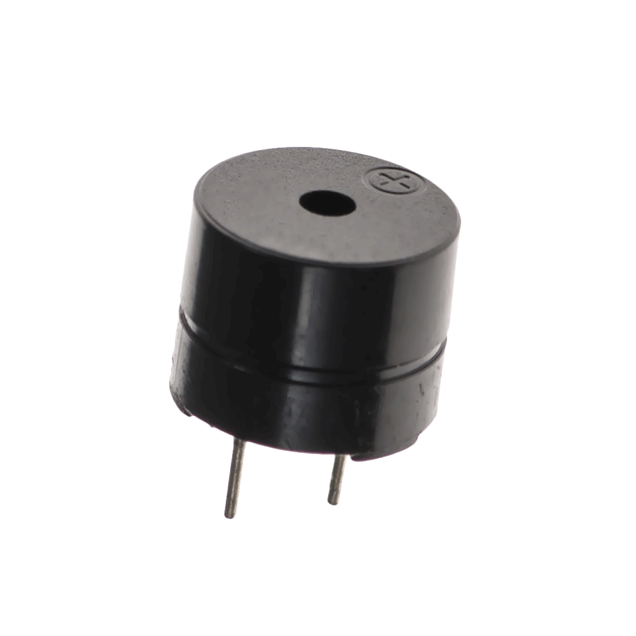
Buzzer

Slide 31
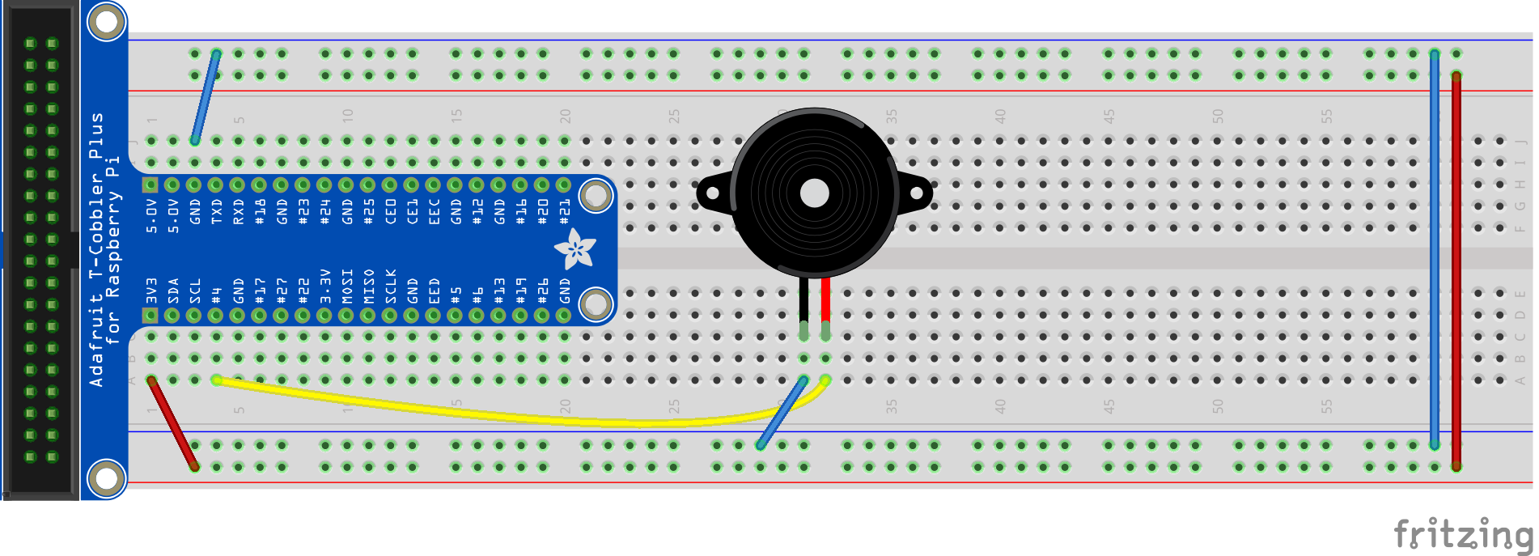
Buzzer - Circuit
Wire from #4 to longer leg
Wire from ground to shorter leg

Slide 32
Make some noise

Slide 33
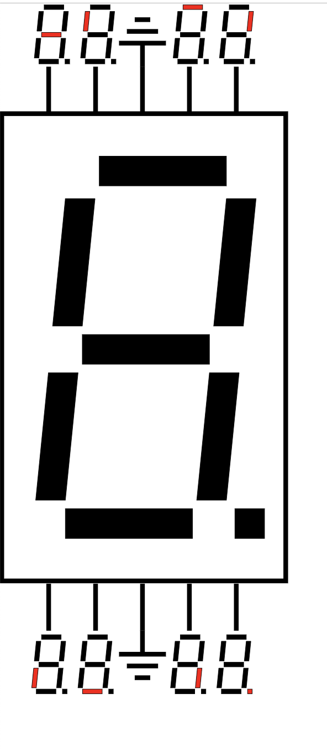
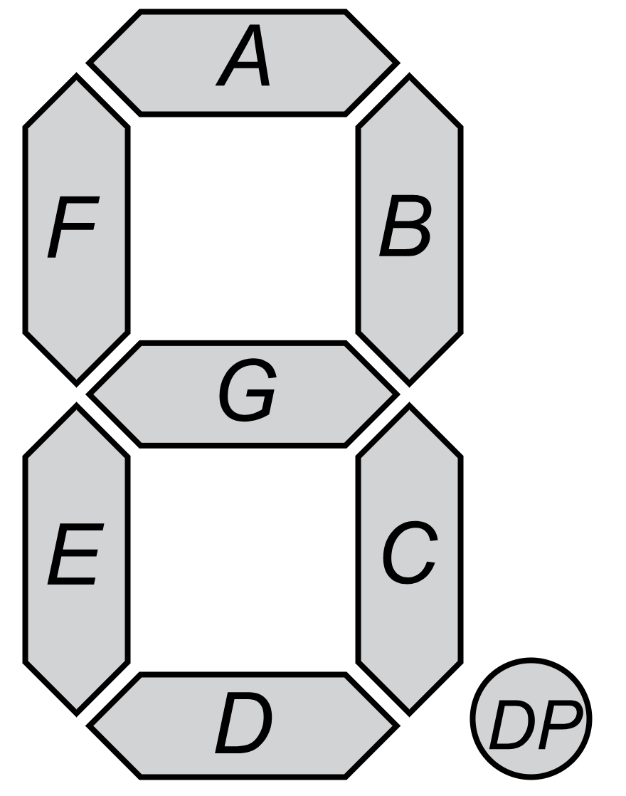
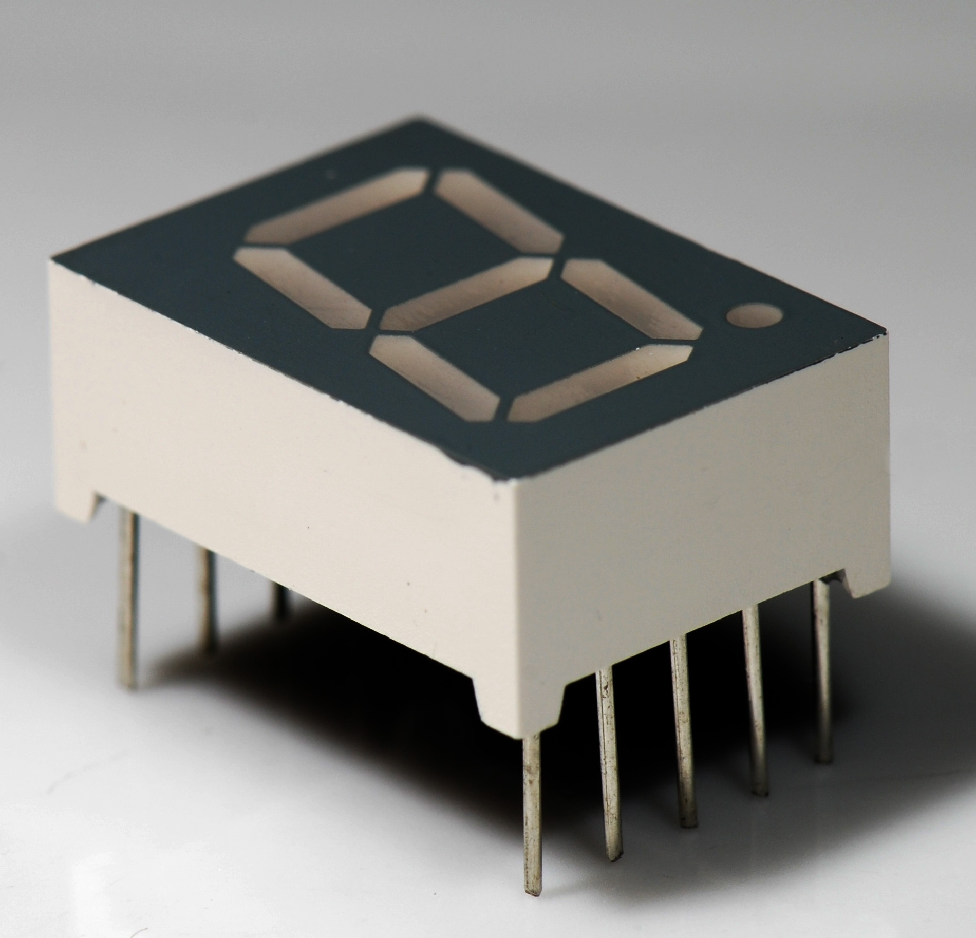
7 Segment
CC BY-SA 3.0, https://commons.wikimedia.org/w/index.php?curid=2550283
By Avh.on1 - Own work, CC0, https://commons.wikimedia.org/w/index.php?curid=48765863
By Uln2003 - Own work, CC0, https://commons.wikimedia.org/w/index.php?curid=69807877

Slide 34
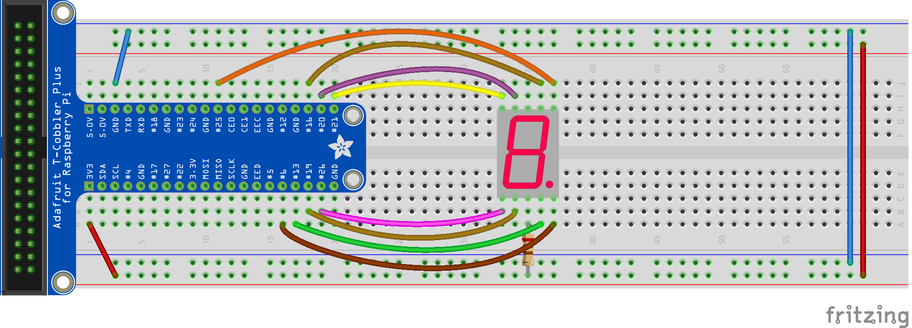
7 Segment - Circuit
Connect the middle bottom pin to the 3.3V + power line via a resistor
Connect the other 8 side pins to any free pins on the raspberry pi
Notes:
Circuit Connections:
- Connect the middle bottom pin to the 3.3V + power line via a resistor - Connect the other 8 side pins to any free pins on the raspberry pi
Python Code:
1. Fix display.py
Open the display.py file found in the CodingWorkshop folder.
Fix the values for a-h depending on which pins you connected them to.
Edit the values in the matrix num depending on the number to be displayed.

Slide 35
7 Segment - Code
1. Fix display.py
Open the display.py file in the CodingWorkshop folder.
Fix the values for a-h depending on which pins you connected them to.
Edit the values in the matrix num depending on the number to be displayed.
2. Code to display a digit - sevenSeg.py
import RPi.GPIO as GPIO
import time
from display import display
GPIO.setmode(GPIO.BCM)
GPIO.setwarnings(False)
GPIO.cleanup()
display(0)

Slide 36
Displace number increasingly/decreasingly
Count the number of times the button is pressed and display on 7-seg

Slide 37
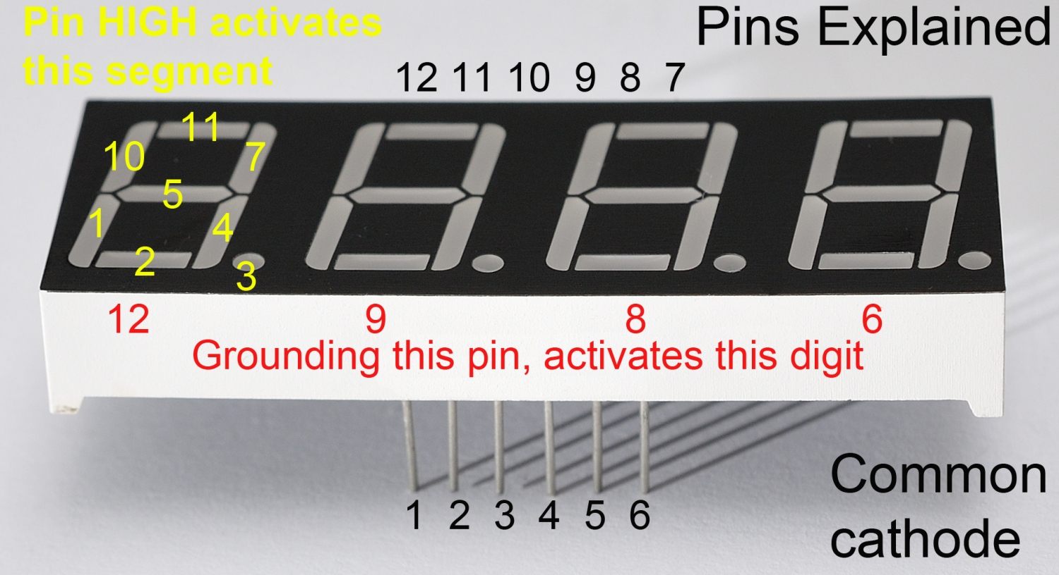
4 Digit 7-Seg
x
https://raspi.tv/2015/how-to-drive-a-7-segment-display-directly-on-raspberry-pi-in-python

Slide 38
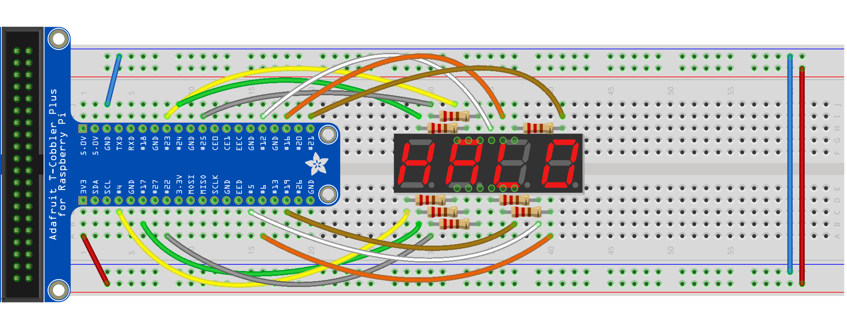
4Digit 7Seg - Circuit

Slide 39
4 Digit 7 Seg - Circuit
Seg / digit | 7Seg Pin | Resistor | BCM GPIO #
Bot left | 1 | Y | 4
Bot centre | 2 | Y | 17
Decimal pt | 3 | Y | 22
Bot right | 4 | Y | 5
Centre centre | 5 | Y | 6
Digit 4 | 6 | N | 19
Top right | 7 | Y | 21
Digit 3 | 8 | N | 16
Digit 2 | 9 | N | 12
Top left | 10 | Y | 25
Top centre | 11 | Y | 24
Digit 1 | 12 | N | 23

Slide 40
Display 4 different numbers at the same time
Make a clock with minutes and seconds

Slide 41
Project -
Smart Home Application

Slide 42
Example
Example system design:
Morning alarm system: alarm rings at 8AM, push alarm button to stop the alarm, and light turns on automatically
=> Buzzer rings when 7seg goes to 8, push button to stop the alarm, and the LED lights up

Slide 43
Project
https://lets-code-p.github.io/ => Gallery
Group Name!
Photo of the project
Short description of the project

Slide 44
Resources
https://projects.raspberrypi.org/en/projects/raspberry-pi-getting-started
https://curriculum.raspberrypi.org/
http://fritzing.org/home/ fritzing: a software to document prototypes, and help to translate into schematics
https://github.com/adafruit/Fritzing-Library
Resistor color code: https://www.digikey.sg/en/resources/conversion-calculators/conversion-calculator-resistor-color-code-4-band
https://romannurik.github.io/SlidesCodeHighlighter/
Notes:
https://www.sgbotic.com/
https://www.robot-r-us.com

